Slide 1

Key population-led health services: Community-based organizations and lay health workers transform HIV testing in Vietnam
Dr Ngo Van Huu, HIV Services Director, PATH
Authors: Ngo Van Huu, Vu Ngoc Bao, Kimberly Green, Phan Huong, Vo Hai Son, Ngo Minh Trang, Le Minh Son, Le Thanh, Doan Thanh Tung, Doan Hong Anh, Bao An, Ha Thi Tra Giang Ha.
Abstract number: THAC0202

Slide 2

One size fits all before 2015
Annual HIV testing uptake was relatively low and steady
HIV testing services were offered in public health facilities
Sources: UNAIDS. HIV investment case, Hanoi, Vietnam, 2015; USAID/PATH Healthy Markets. Key population consumer survey final report, December 2015; MoH, HSS+ results 2015 & 2016, Hanoi, Vietnam, 2017 ; Sources: Estimation and Projection Package; C/R: case reports; D28: routine monitoring as per Decision 28. Source: US Centers for Disease Control. Situation Analysis. DRAFT. 2014.
Notes:
I would like to start with some background information:
Before 2015, HIV testing services were only offered in public health facilities.
This led to low and steady uptake of annual HIV testing among key population. It was around 30%.
The figure on the screen showed the uptake of HIV testing among key populations in three consecutive years

Slide 3
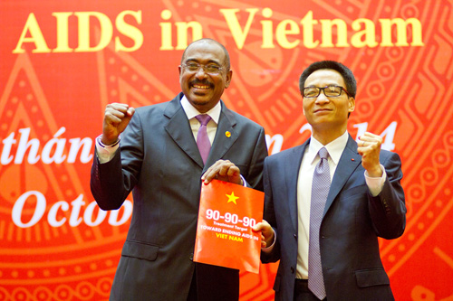
Enter 90-90-90…
Opening the door for many differentiated services:
HIV lay provider and self testing
Partner notification index testing services
PrEP and nPEP
ART
Sources: UNAIDS. HIV investment case, Hanoi, Vietnam, 2015

Slide 4
Pilot objectives
In October 2015, with approval from the Ministry of Health, USAID/PATH Healthy Markets piloted HIV lay provider (and self testing) services with the objective to:
  Accelerate HIV testing uptake among key populations as part of 90-90-90 efforts
  Determine feasibility and acceptability of HIV lay provider and self testing among key populations, community based organizations and health staff
  Measure effectiveness of referral from HIV community testing to confirmatory diagnosis, and ART enrollment
Notes:
With approval from Ministry of Health in Oct 2015, USAID/PATH Healthy Markets piloted HIV lay provider and self testing services with three following objectives:
To accelerate HIV testing uptake among key populations as part of 90-90-90 efforts
To determine feasibility and acceptability of HIV lay provider and self testing among key populations, community based organizations and health staff
To measure effectiveness of referral from HIV community testing to confirmatory diagnose and HIV care and treatment

Slide 5
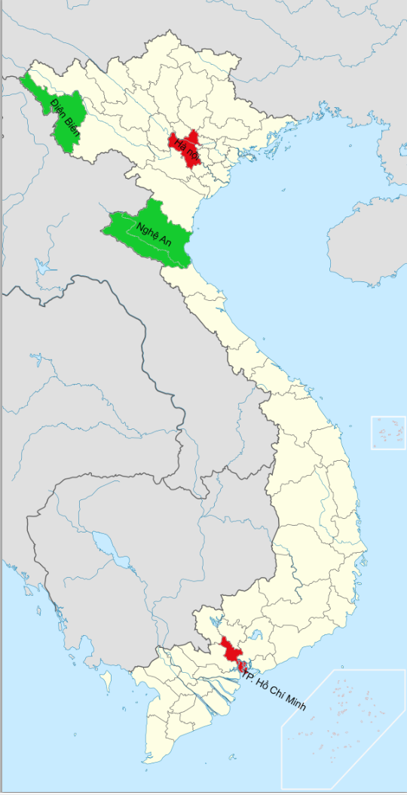
Intervention description
 | Urban | Rural
Localities | Hanoi, Ho Chi Minh City | Nghe An, Dien Bien
Focal populations | MSM, TGW, PWID, FSW and sex partners | PWID, FSW and sex partners
Lay providers | CBO staff | Village health workers
Test kits used | Determine HIV1/2 Ab OraQuick Rapid HIV 1/2 Ab | Determine HIV 1/2 Ab
Capacity building for lay providers | Training on HIV testing Hand on coaching and mentoring during service delivery
Notes:
In this program, we piloted two models: urban and rural models, in Ha Noi, HCMC and Dien Bien, Nghe An.
You can see some differences and similarities between the two models.
In urban models, we trained KP-led community based organization staff as lay providers, while in rural model we trained village health workers;
While in rural model, we used only blood-based test kits, in urban model, we used both blood-based and oral fluid based test kits. The purpose of this is to provide more choices to clients and to test acceptability of KP on oral fluid based test.

Slide 6
HIV lay testing process: from pilot to program
Approval
Initiated HIV lay testing
MOH-led mid-term and final reviews
Scaling up
Oct 2015 MOH approval for HIV lay testing pilots by PATH and WHO
Dec 2015 Started in two rural provinces then expanded to two urban sites in Jan 2016
November 2016 and 2017 Reviewed key results and lessons
From 2016 on. Offered in more than 32 provinces; National HIV community testing guidelines approved (4/2018)
Notes:
In this slide, I would like to summarize the implementation process.
In Oct 2015: The ministry of Health approved HIV lay and self testing pilots, implemented by PATH and WHO;
Right after the approval, in Dec 2015, we started the pilot in two rural provinces and then expand to two urban sites;
We conducted mid term review after one year and final review after two years to review the results and lesson learned of the pilot;
The HIV lay provider and self testing services were acknowledged to work very well in Vietnam. The Vietnam Authorities for HIV/AIDS Control decided to scale up the services nationwide by approval of the National Guidelines on HIV community testing in April of this year

Slide 7
Key results (Oct 2015 – Sep 2017)*
Urban: 6.8% HIV positivity yield
4.3%
98.2%
90.8%
*Indirect comparison: 1.6% HIV positivity yield among KP in public facilities
Notes:
Up on the screen, you can see the cascade of HIV lay and self testing in two years:
- The positivity yield is 4.3%, which is much higher than 1.6% yield among KPs testing in public sites;
- More importantly, the connection to confirmatory test and to care and treatment is very high, over 90%

Slide 8
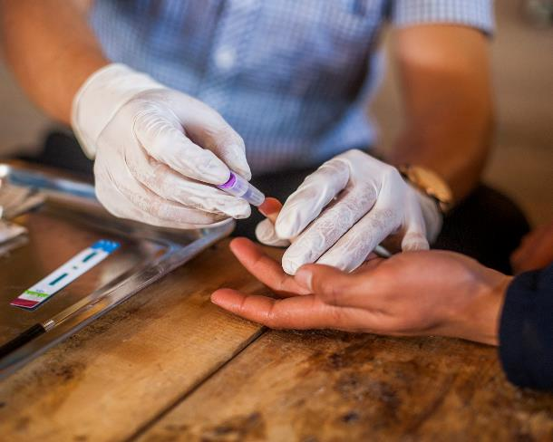
Convenience and comfort
New confidence and capacity
“Community-based testing is so convenient and friendly. I can be tested at any time, any place, and I feel very comfortable doing so. The test is also fast, I don’t have to wait long for the results.”
MSM client of G-Link, HCMC
“Our clients know and trust us, and the procedure is very simple and convenient. One of the aspects our clients value most is that they don’t need to travel to get tested like before.”
VHW lay provider, Nghe An
“Since we delivered HIV lay testing, we feel very confident and empowered. Our community trusts us and our roles have increased as CBOs”
Le Minh Thanh – G-Link, HCMC
Notes:
Findings from our qualitative surveys also proved that HIV lay provider and self testing is convenient for clients.
An MSM clients in HCMC said that “Community-based testing is so convenient and friendly. I can be tested at any time, any place, and I feel very comfortable doing so. The test is also fast, I don’t have to wait long for the results.”
Or a lay tester in rural area felt that “Our clients know and trust us and the procedure is very simple and convenient. One of the aspects our clients value most is that they don’t need to travel to get tested like before.”
And the lead of a KP-led social enter shared with us that “Since we delivered HIV lay testing, we feel very confident and empowered. Our community trust us and our roles have increased among CBOs”

Slide 9
Reaching new HIV testers…
% of clients tested by lay providers who have never been tested for HIV
Source: USAID/PATH Healthy Markets: HIV lay testing pilot evaluation study, November 2017
Notes:
This graph presented that results from an operation research that two third of clients tested by lay providers are those have never been tested for HIV before. It may vary among KP groups.

Slide 10
Lesson learned
Lay testers were capable of offering HIV testing with exceptional skill and engagement in HIV lay testing boosted CBOs confidence and pride in their work
Lay testers were highly effective at facilitating HIV diagnosis and ART enrollment
Among those tested by lay testers, more than half were first time testers
Fostering close MOH engagement in and observation of lay testing translated into their significant trust and support of this new service
“HIV testing offered by lay providers increased access to testing…initial results demonstrated that [it] has been successful in reaching key populations that had never tested or only infrequently tested for HIV, and yet were at high risk of HIV.”
Prof. Nguyen Hoang Long, Director General, VAAC, MOH
Notes:
From this pilots, we learned that:
Lay testers were capable of offering HIV testing with exceptional skills and engagement in HIV lay testing boosted CBOs confidence and pride in their work
Lay testers were highly effective at facilitating HIV diagnosis and ART enrollment
Among those tested by lay testers, more than half were first time testers and 4.3% were newly HIV diagnosed (vs. 1.6% among KPs testing in public sites)
Fostering close MOH engagement in and observation of lay testing translated into their significant trust and support of this new service
As mention by Prof. Nguyen Hoang Long, Director General of VAAC at the end-pilot review workshop “HIV testing offered by lay providers increased access to testing…initial results demonstrated that [it] has been successful in reaching key populations that had never tested or only infrequently tested for HIV, and yet were at high risk of HIV.”

Slide 11
Conclusions: Learning from the pilot contributed to…
MOH approval for national HIV community testing guidelines in April 2018
HIV lay testing scale-up by MOH, PEPFAR partners, Global Fund and WHO reaching >100,000 key populations
Stepwise rollout of HIV lay testing that has positively disrupted the status quo and has opened the door for KP-led HIV services including KP owned private clinics offering PrEP and ART!
“The program is responding to the real needs of a community that has been waiting for this a long time. We see there is great potential for fee-based services to sustain our work in the future.” Nguyễn Công Hậu, G3VN lay tester
Notes:
These lessons have helped in the advocacy process to achieve:
MOH approval for national HIV community testing guidelines in April 2018
HIV lay testing scale-up by MOH, PEPFAR partners, Global Fund and WHO reaching >100,000 key populations
Stepwise rollout of HIV lay testing has opened the door for KP-led HIV services including KP owned private clinics offering PrEP and ART!

Slide 12
Acknowledgements
CBOs/Social enterprises/Private clinics: Lighthouse (Doan Tung), V-Smile, G3VN, Aloboy, M4M, Color of Life, Love Boy, V-Smile, Strong Ladies, National Network of TGW, Lighthouse, G-Link Clinic, Galant Clinic, My Home Clinic, The Light clinic
MoH/VAAC: Assoc. Prof. Nguyen Hoang Long, Assoc. Prof. Phan Thi Thu Huong, Dr. Vo Hai Son, Dr. Do Thi Nhan
USAID Vietnam: Ms. Ngo Minh Trang, Ms. Nguyen Thi Minh Huong, Dr. John Eyres, Ms. Mei Mei Peng\
PATH: Dr. Kimberly Green, Dr. Vu Ngoc Bao, Ms. Tran Thi Tham, Mr. Viet Dung, Ms. Doan Hong Anh, Mr. Bao An, Dr. Nguyen Thi Hoang Yen; Dr. Johannes van Dam
WHO: Dr. Nguyen Thi Van
Notes:
I would like to close my presentation by acknowledging:
Many CBOs/SE/Private KP-led clinics, who are present here at the conference for their implementation of the services;
Leader and key staff of the MOH/VAAC for their leadership and coordination during the pilot;
USAID Vietnam representatives
And of course, leaders and members of my team at PATH Vietnam and my colleague from WHO Vietnam
Thank you very much!

